Slide 1
PYTHON PROJECT : EXPLORATORY DATA ANALYSIS (EDA)

Slide 2
BUSINESS OBJECTIVE
Case Study: Bank Telemarketing Campaign
The bank aims to enhance its revenue by conducting a cost-efficient telemarketing campaign for term deposits among existing customers. Term deposits, fixed investments with predetermined interest rates, serve to foster long-term customer relationships. The objective is to conduct an end-to-end Exploratory Data Analysis (EDA) on the campaign dataset, identifying patterns and providing insights to improve the positive response rate. The analysis will involve examining customer demographics, temporal trends, and other factors influencing the success of the campaign, ultimately offering recommendations for targeted improvements in the bank's marketing strategy.

Slide 3
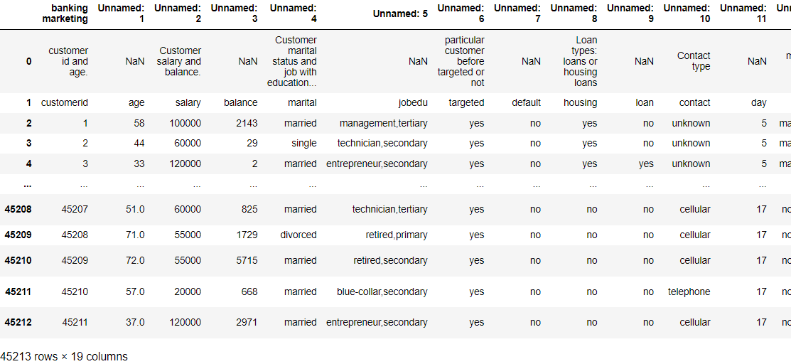
Exploratory Data Analysis (EDA) is the process of summarizing, visualizing, and understanding the main characteristics of a dataset. In our bank telemarketing campaign project, EDA involves examining the dataset to gain insights into customer demographics, temporal trends, and factors influencing the success of the campaign.
1. Data Collection: The first step in EDA is gathering the dataset containing information about the bank's telemarketing campaign, including customer demographics, campaign outcomes, and contact details.

Slide 4
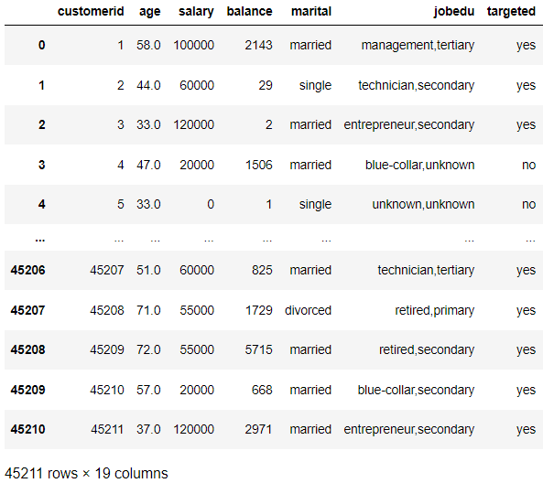
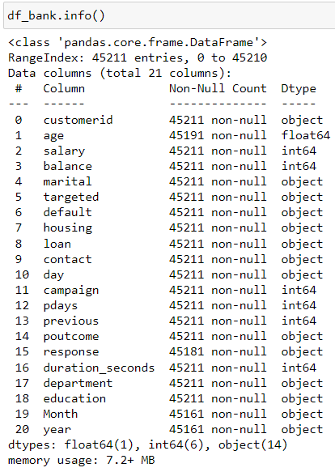
2. Data Understanding & Cleaning: Before conducting analysis, it's essential to clean the data by inspecting for any instances of missing values, outliers, or data inconsistencies. This ensures that the data is accurate and reliable for analysis.

Slide 5
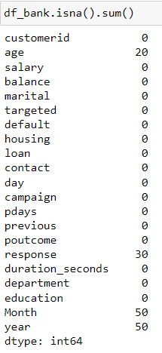
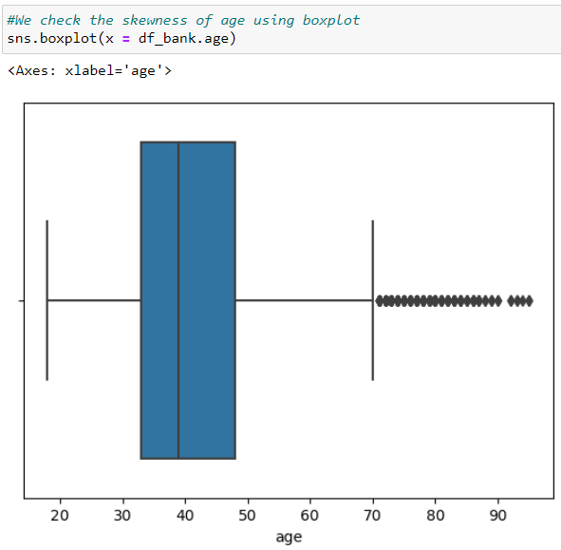
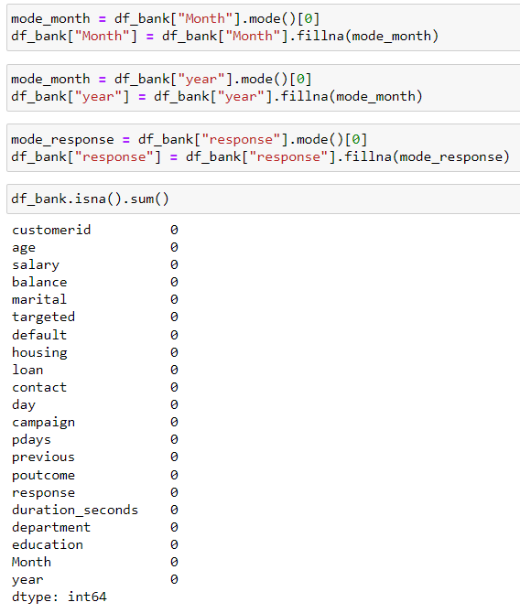
Find out the missing data value
Here we have some missing values in Age, Month, Year and Response column, so we use different function like mean, median or mode according to the situation
As we can see the 'age' column is heavily skewed by outliers, we will be using median here to fill the missing values.
For Month and Response we use mode as the are object type(text data).

Slide 6
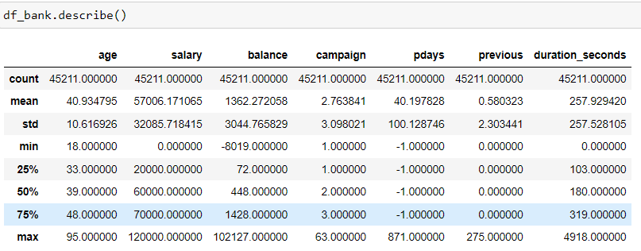
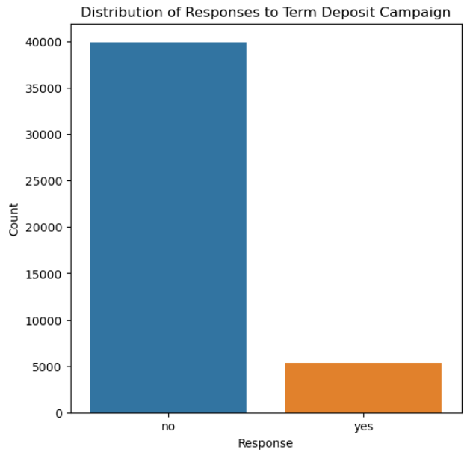
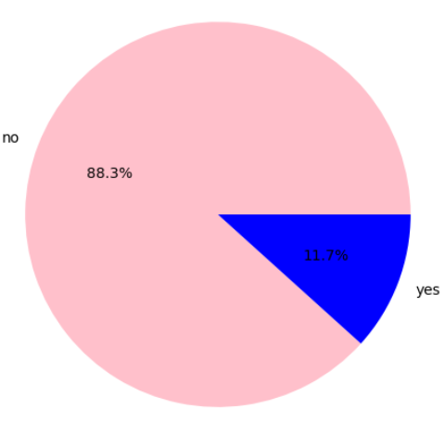
3. Descriptive Statistics: Calculate summary statistics such as mean, median, standard deviation, and range for numerical variables. This provides an overview of the central tendency, dispersion, and distribution of the data.
To examine the distribution of the target variable, we can use various visualization techniques. Since the target variable is categorical ('response': 'yes' or 'no'), we can create a count plot or a pie chart to visualize the distribution of responses.

Slide 7
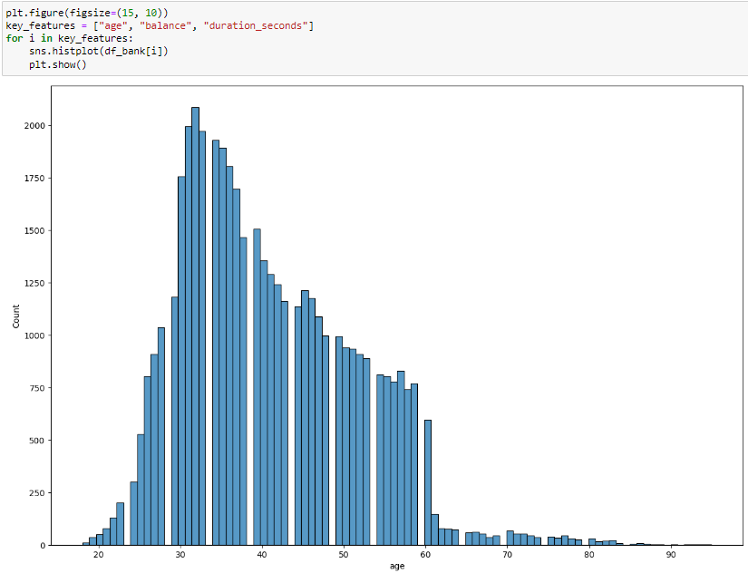
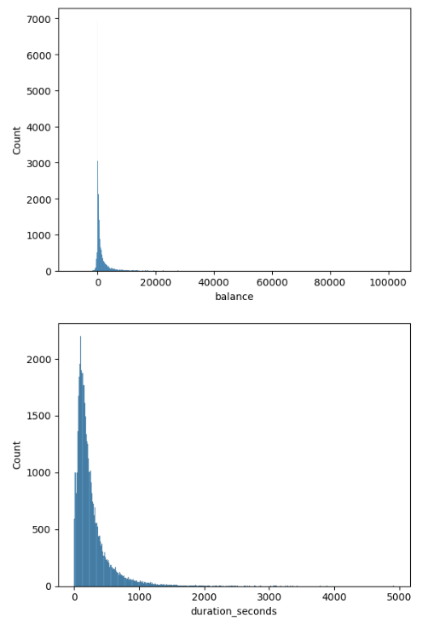
4. Univariate Analysis
A. Examine the distribution of individual key features, such as age, balance, and call duration

Slide 8
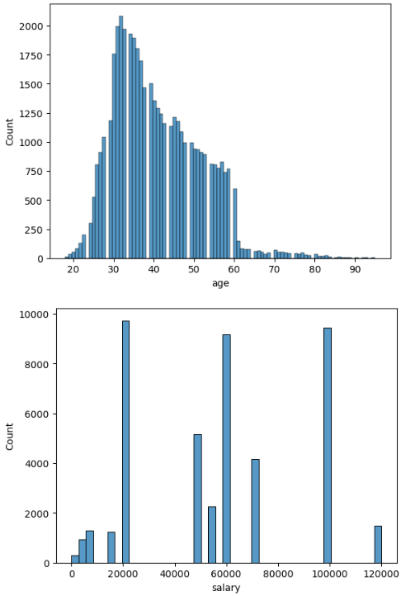
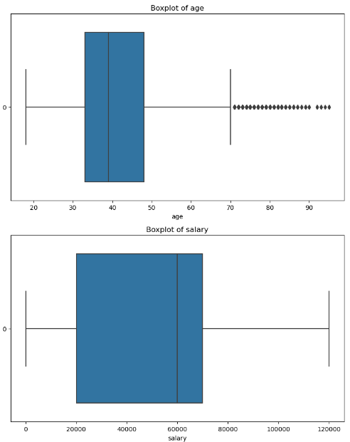
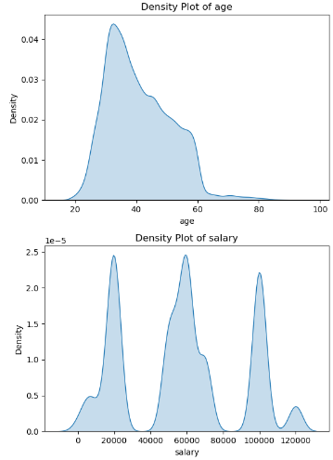
B. Employ visual aids like histograms, box plots, and kernel density plots to discern patterns and outliers.
Histograms for Numerical columns like age, salary, balance, campaign, pdays, previous & duration_seconds

Slide 9
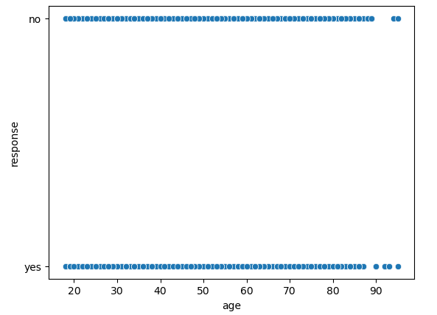
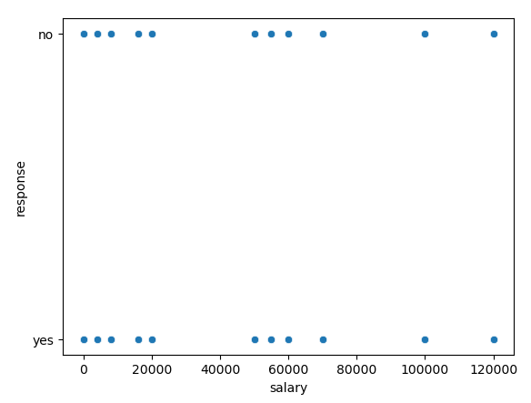
5. Bivariate Analysis
Evaluate the relationship between independent variables and the target variable.
Explore relationships between pairs of variables to identify correlations and associations. For example, analyze how customer
demographics (e.g., age, marital status) relate to campaign outcomes (e.g., response rate).We will be using scatterplot here for
bivariate Analysis

Slide 10
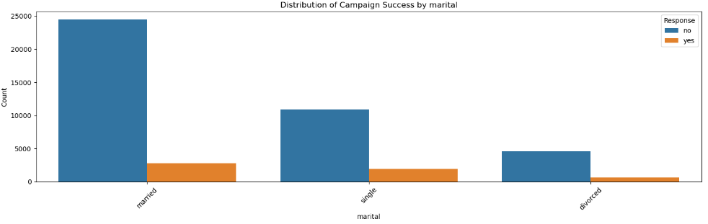
B. Analyze how features like age, job type, education, marital status, etc., associate with the success of the term deposit campaign, using visualizations like bar charts, stacked bar charts, and heatmaps.
BAR CHART for categorical variables

Slide 11
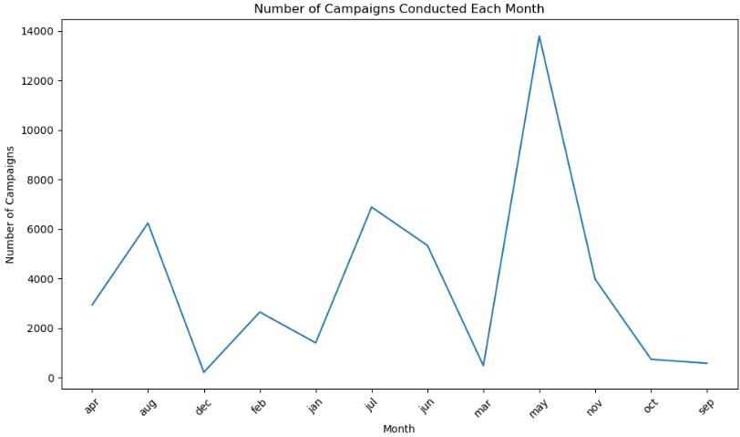
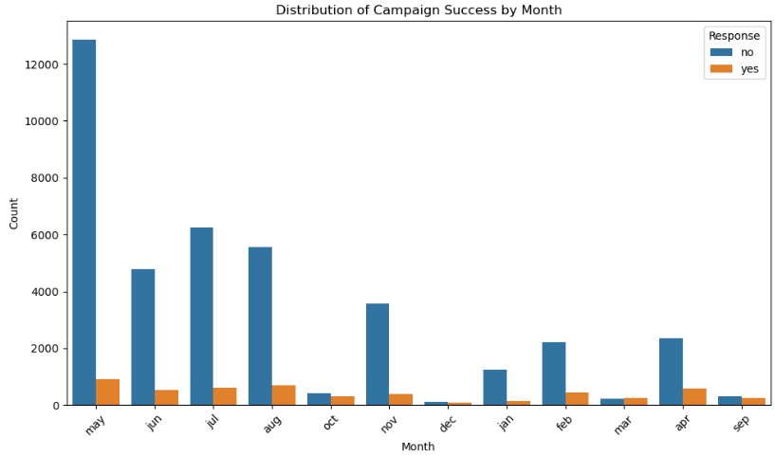
6. Temporal Analysis: Investigate temporal trends by analysing how campaign outcomes vary over time (e.g., by month, day of the week). This helps to identify seasonality and patterns in customer behaviour.
Investigate temporal patterns of the campaign over time.
We'll be using line plot to visualize temporal patterns
B. Analyse if specific months or days exhibit superior campaign perfor
-mance.

Slide 12
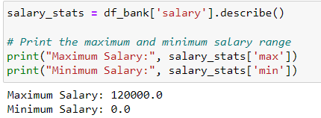
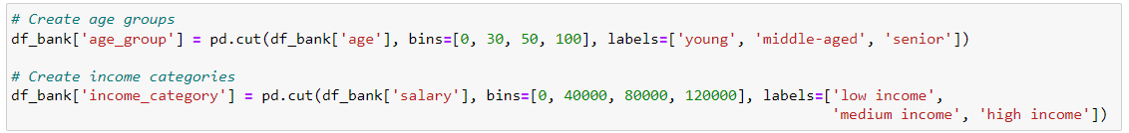
7. Feature Engineering
A. Introduce new features that may enhance prediction, such as creating age groups or income categories.

Slide 13
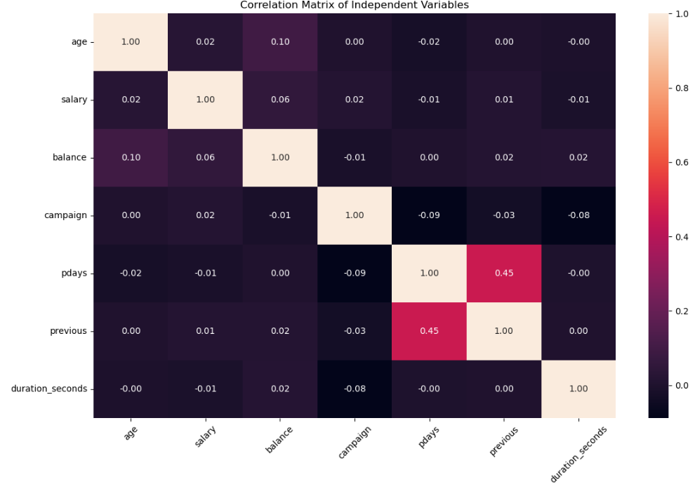
8. Correlation Analysis
A. Examine correlations between independent variables to identify multicollinearity.

Slide 14
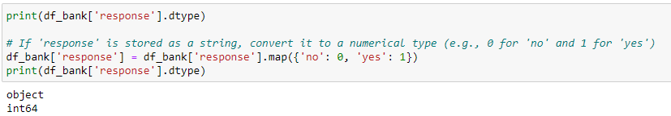
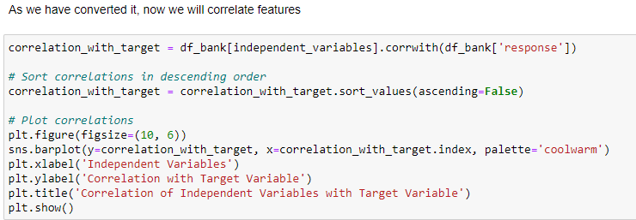
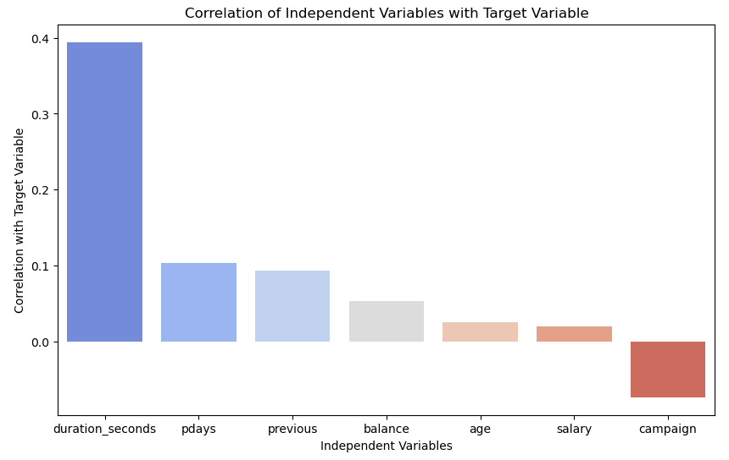
B. Evaluate how correlated features may influence the target variable.
As response column includes string data, so first we need to change it to integer or numerical data

Slide 15
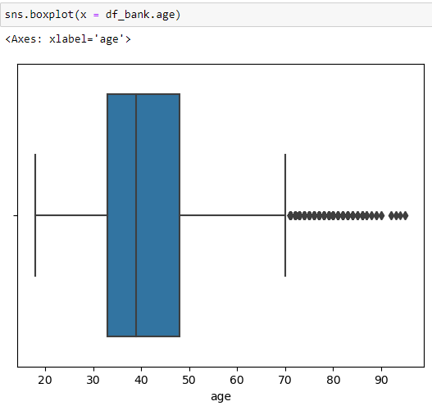
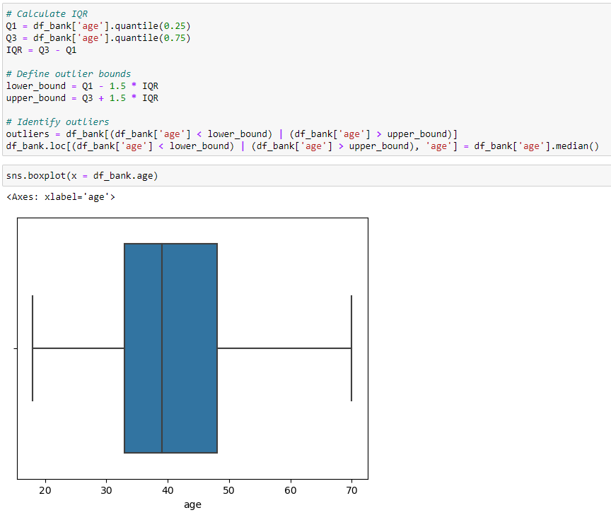
9. Outlier Detection and Handling
A. Identify and rectify outliers that could impact the analysis and predictions. Here we will handle outliers using the interquartile range (IQR) method:

Slide 16

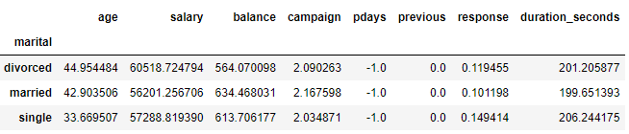

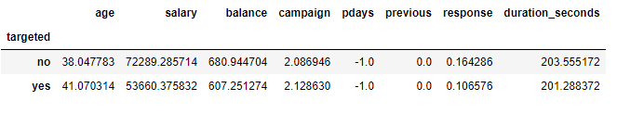
Now we summarize and compare the average values of numerical variables across different statuses, providing valuable insights into the dataset.

Slide 17
Thank you

